Slide 1
Yogurt: a long-standing food to help restrain modern disease Angelo Tremblay Department of Kinesiology Laval University

Slide 2
Conflict of interest
I wish to declare a potential conflict of interest, and that I have received either direct or indirect industry support in relation to some results presented here:
General Mills
Danone
Dairy Farmers of Canada
Dairy Research Institute (USA)

Slide 3
Current health status of populations
Obesity remains a major problem: the situation
in Belgium

Slide 4
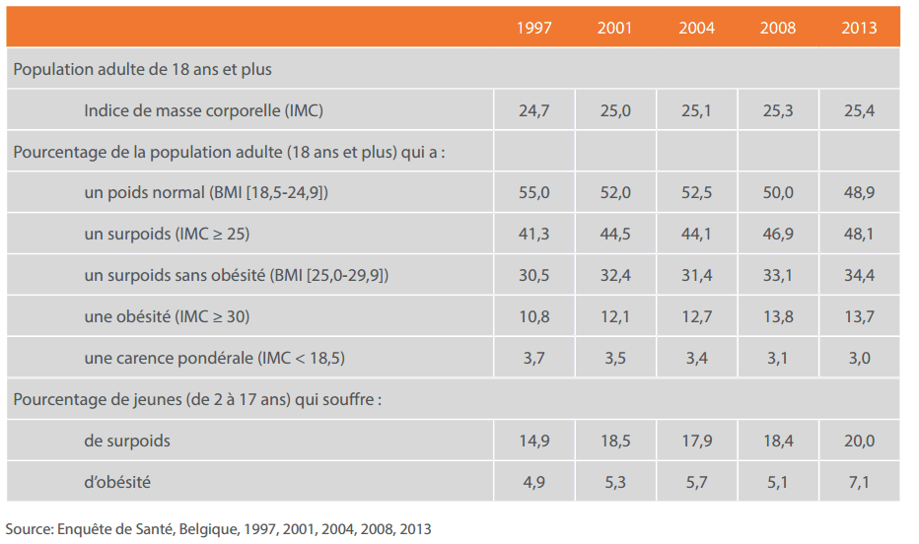
Obesity & overweight in Belgium

Slide 5
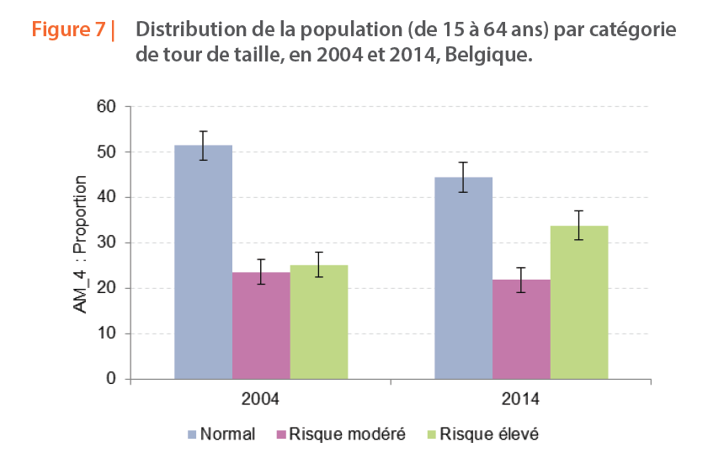

Slide 6
“It is abundantly clear that the current epidemic
of diabetes is being driven by the epidemic of obesity” De Fronzo RA Diabetes 58: 773-795, 2009

Slide 7
Why are we more obese?

Slide 8
Inadequate macronutrient intake
Insufficient micronutrient intake
Alcohol consumption
Sedentary behavior
Lack of exercise
Short sleeping / Poor sleep quality
Inadequate feeding behaviors
Persistent organic pollutants
Demanding mental work
Suboptimal gut microbiota
Increase in atmospheric CO₂ ?
_{X}
Heredity
Energy
expenditure
Energy
intake

Slide 9
Risk factors related to obesity and diabetes: Is insufficient dairy intake part of the problem?

Slide 10
A story initially oriented on calcium

Slide 11
Dietary calcium in human hypertension
SUBJECTS Mean calcium intake (mg/day)
Normotensive 886
Controls
Hypertensives 668
From McCarron DA et al, Science 217:2, 1982

Slide 12
Calcium intake vs BMI
0-30
31-60
61-90
91-100
McCarron DA et al. Science 1984;224:1392-8.

Slide 13
1988
Reaven describes Syndrome X (metabolic syndrome) which is a suboptimal metabolic state reflecting the progression from a healthy to a pathological state.

Slide 14
Ten year cumulative incidence (%) of the insulin resistance (IR) syndrome components in low and high dairy consumers with stratification by baseline overweight status
IR component | Dairy consumer | BMI (kg/m²)
 |  | > 25 | < 25
Abnormal glucose homeostasis | Low | 29.1 | 6.5
 | High | 15.5 | 5.3
Dyslipidemia | Low | 21.4 | 12.0
 | High | 13.0 | 8.0
Low and high dairy consumption correspond to < 10 and > 35 servings per week
Adapted from Pereira et al, JAMA 287: 2081-9, 2002

Slide 15
The contribution of Professor Michael Zemel

Slide 16
Effects of calcium or dairy intake on the risk of being in the highest quartile
of body fat for women
Quartile of calcium and dairy intake | Calcium intake (mg/day; mean ± SEM) | Dairy intake (serving/month; mean ± SEM) | Odds ratio of being in the highest body fat quartile
1 | 255 ± 20 | 14.4 ± 1.9 | 1.00
2 | 484 ± 13 | 38 ± 1.3 | 0.75
3 | 773 ± 28 | 57.2 ± 1.0 | 0.40
4 | 1346 ± 113 | 102.8 ± 3.6 | 0.16
Adapted from Zemel et al, FASEB J 14: 1132-8, 2000

Slide 17
Calcium and fat loss
*
*p<0.01
Fat mass (kg)
Adapted from Zemel et al. FASEB J 2000;14:1132-8.
Adapted from Zemel et al. FASEB J 2000;14:1132-8.

Slide 18
Calcium and dairy acceleration of weight and fat loss during energy restriction in obese adults Zemel M, Thompson W. Milstead A, Morris K, and Campbell P. Obes Res 12: 582-590, 2004
Objective
To determine the effects of increasing dietary calcium in the face of caloric restriction in humans

Slide 19
Key methodological points
Recruitment of obese low calcium consumers (500-600mg/d)
Testing under balanced deficit conditions (500 kcal/d deficit)
Three testing conditions including a supplemented calcium diet and a high dairy diet containing the same amount of calcium (1200 to 1300 mg/day)
Duration of the intervention: 24 weeks
Zemel M et al, Obes Res 12: 582-590, 2004.

Slide 20
Mean change in body weight and body fat
 | Treatment
 | Low calcium | High calcium | High dairy
weight (kg) | 6.60 | 8.58 | 11.07
fat (kg) | 4.81 | 5.61 | 7.16
fat / weight | 0.73 | 0.65 | 0.65
Adapted from Zemel et al, Obes Res 12: 582-90, 2004

Slide 21
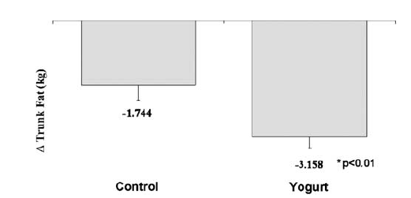
Effects of dietary treatments on trunk fat loss
From Zemel et al, IJO 29: 391-397, 2005

Slide 22
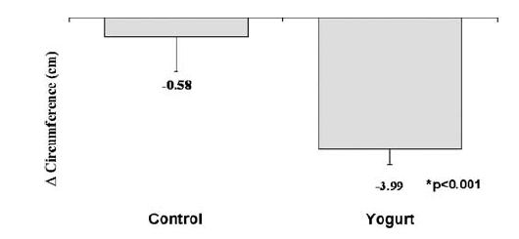
Effects of dietary treatments on waist circumference
From Zemel et al, IJO 29: 391-397, 2005

Slide 23
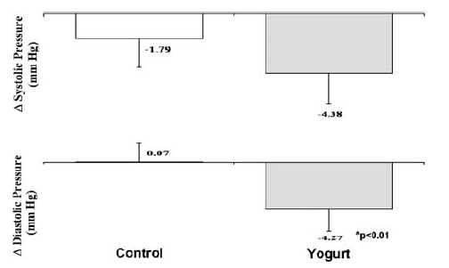
Effects of dietary treatments on systolic (top panel) and diastolic (bottom panel) blood pressure
From Zemel et al, IJO 29: 391-397, 2005

Slide 24
Dairy food, appetite control and obesity

Slide 25
« Rats fed with a low-calcium diet during 6 weeks developped a preference for CaCl₂ solution.
This indicates that rats deprived of an adequate source of calcium developped a calcium appetite ».
Paradis S and Cabanac M, Physiology & Behavior, 2005; 85: 259-64.
« Calcium appetite is the motivation to seek out or choose calcium-containing items.
Calcium appetite might be compared with the appetite for glucose or energy, because unlike sodium homeostasis, these involve a reservoir (bone for calcium, glycogen and/or fat for glucose and energy) » .
Tordoff MG, Physiological Reviews, 2001;81:1567-97.

Slide 26
Mean change in body weight, fat mass, and ad libitum lipid intake
(test meal) in very low calcium obese consumers in response to diet restriction with or without calcium + vitamin D supplementation
Mean change in: | Calcium + vitamin D | Control
Body weight (kg) | -5.8 | -1.4*
Fat mass (kg) | -4.7 | -1.2*
Lipid intake (g) | -18.2 | 7.5*
* P < 0.05
Adapted from Major G et al. Br J Nutr 102: 659-663, 2009.

Slide 27
Experimental design
Meal Breakfast Snack (Yogurt (Y)) Buffet-type meal
Time 8 10 12
VAS VAS
Energy
intake
Y1: r* = 1.5:1
Y2: r = control, r = 2.8:1
* r = casein/whey protein ratio. r in milk = 4.5:1
From Doyon, C. et al. APNM, 40: 980-989, 2015.

Slide 28
Mean spontaneous energy intake and appetite sensations following yogurt consumption
Condition | Energy intake (kcal) | Hunger (mm x min) | PFC (mm x min) | Appreciation (mm)
Y1 (high whey) | 1216* | 1422 | 1031 | 87
Y2 (control) | 1410 | 1785 | 1573 | 82
* P < 0.05
From Doyon, C. et al. APNM, 40: 980-989, 2015.

Slide 29
The reducing effect of the high-whey yogurt on subsequent energy intake exceeded
its energy content
 | kcal
Decrease in subsequent energy intake versus control | 194
Energy content of the yogurt snack | 63
Difference | 131
Adapted from Doyon, C. Et al. APNM, 40: 980-989, 2015.

Slide 30
Dairy intake, including yogurt, and metabolic health: the experience of the Harvard group

Slide 31
Higher dairy intake during adolescence is associated with lower incidence of type 2 diabetes
37,038 women who completed food questionnaires about their diet in high school were tracked for diet and diabetes incidence from 1998-2005
Those with higher dairy intake in high school had a 38% lower risk for developing type 2 diabetes as adults
Need to sustain dairy intake in adulthood to maximize risk reduction
Relative Risk
Current
High School
Redrawn from: Malik et al. Am J Clin Nutr vol. 94, 2011

Slide 32
YOGURT AND DIABETES
18% lower risk
of diabetes per one yogurt serving
The Australian Diabetes Obesity and Lifestyle Study
The Whitehall II Prospective Study
EPIC-Interact Study
Women’s Health Initiative
Japan Public Health Center–based Prospective Study
Women’s Health Study
Health Professional Follow-up Study
Nurses Health Study I
Nurses Health Study II

Slide 33
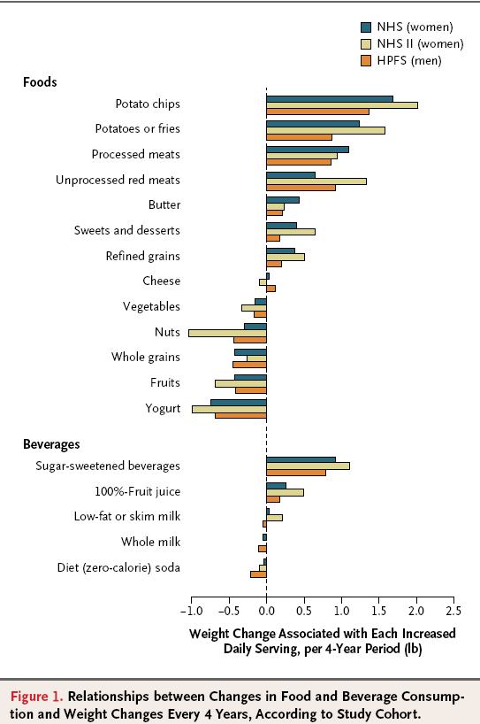
From Mozaffarian et al. N Engl J Med 2011; 364:2392-2404

Slide 34
Looking for additional benefits in the real life

Slide 35
Yogurt to increase nutrient intake and diet quality

Slide 36
Relative contribution of a portion (175 g) of plain yogurt to energy and nutrient intakes
Nutrient | Nutrient Content | DRI for women | Women (% daily intake) | DRI for men | Men (% daily intake)
Energy (kcal) | 114 |  | 6ª |  | 4.5ª
Protein (g) | 9.5 | 46 | 21 | 56 | 17
Calcium (mg) | 332 | 1000 | 33 | 1000 | 33
Magnesium (mg) | 30.8 | 320 | 9.6 | 420 | 7.3
Phosphorus (mg) | 261 | 700 | 37 | 700 | 37
Riboflavin (mg) | 0.39 | 1.1 | 35 | 1.3 | 30
Zinc (mg) | 1.6 | 8 | 20 | 11 | 14.5
Vitamin B12 (µg) | 1.0 | 2.4 | 42 | 2.4 | 42
ªBased on a 2000 kcal/d diet and 2500 kcal/d diet for women and men, respectively.
Adapted from Panahi and Tremblay J Am Coll Nutr 2016

Slide 37
Yogurt and dairy consumption in U.S. adults: from Framingham Heart Study Offspring
(1998-2001) & Third Generation (2002-2005) cohorts
Yogurt consumers compared with non-consumers, had higher potassium intakes (difference, 0.12 g/d)
And were 47%, 55%, 48%, 38%, and 34% less likely to have inadequate intakes (based on DRI) of respectively (all p≤ .001):
Vitamins B2 and B12
Calcium
Magnesium
Zinc
From Wang H et al. Nutr Res. 33: 18-26, 2013

Slide 38
Differences between female yogurt consumers and non-consumers for nutrients in which yogurt
is not a primary source
Variable | Yogurt Consumption |  | P-value¹
 | Non-consumers (0 servings/day) | Consumers (≥ 1 servings/day)
WOMEN
N | 62 | 21
Pantothenic acid (mg/day) | 4.1 ± 1.7 | 5.5 ± 1.8 | 0.003
Folic acid (mg/day) | 167 ± 69 | 219 ± 81 | 0.01
Iron (mg/day) | 14 ± 4 | 16 ± 6 | 0.03
Manganese (mg/day) | 0.7 ± 0.6 | 1.5 ± 2.6 | 0.02
Copper (mg/day) | 1.0 ± 0.8 | 1.2 ± 1.0 | 0.03
¹ The model was adjusted for age, physical activity and % body fat. Data are means ± SD.
Panahi et al. 2016 (in preparation)

Slide 39
Yogurt: the signature of a healthy lifestyle

Slide 40
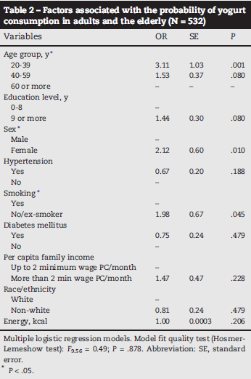
Yogurt consumption is associated with a healthier lifestyle in Brazilian population
Per capita family income and being a nonsmoker were factors positively
associated with the amount of yogurt consumption (coefficients, 0.61 and 3.73, respectively)

Slide 41
Yogurt consumption is associated with a healthier lifestyle
in Italian population
Among adults, yogurt consumers were 40% more likely to practice physical activity (≥ 2h/week), 30% less likely to smoke than non consumers (p<0.05).
Yogurt consumers were more likely to have a good knowledge of the food-health relationship and accustomed to reading food labels (p<0.05).
D’Addezio et al. Sociodemoographic and lifestyle characteristics of yogurt consumers in Italy: Results from the INRAN-SCAI 2005-06 survey. Med J Nutrition Metab 8 (2015) 119-129

Slide 42
The palatability dilemma

Slide 43
The palatability dilemma… for the food industry
satiety
acceptability/
consumption
Production of healty food promoting
Key question:
Is it possible to design foods with enhanced palatability (to promote and ensure consumption) and at the same time to improve satiety (which implies a reduction in the desire to eat)?
From: Yeomans et al, Br J Nutr 92: S3-S14, 2004

Slide 44
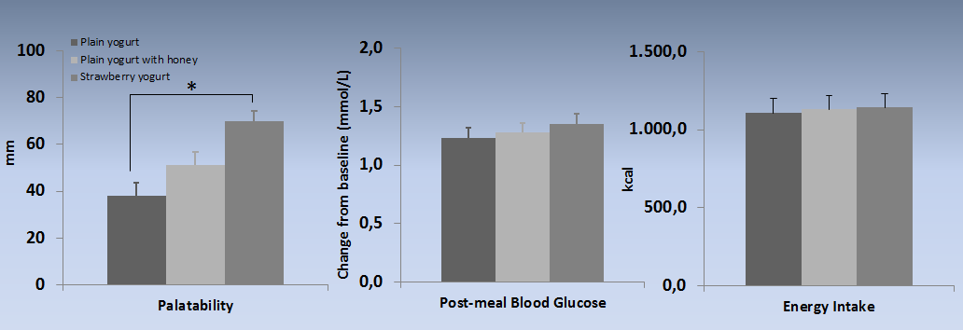
Palatability, post-meal blood glucose and subsequent energy intake after consumption of different yogurts.
El khoury et al. Clin Nutr 2014

Slide 45
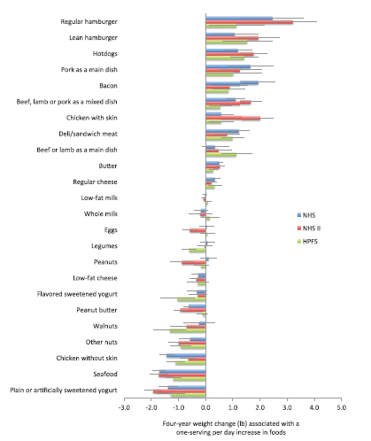
From Mozaffarian ; Circulation 2016 ;133:187-225

Slide 46
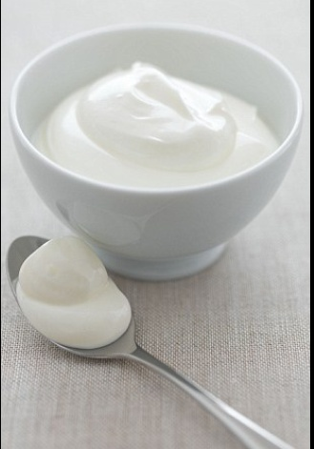
Yogurt: a long-standing food to help restrain modern disease

